Slide 1
Matching Estimators
Oct 22, 2024

Slide 2

Outline
Why matching and what is needed?
Types of matching
How to choose $X$’s and run specification tests
Matching and Difference-in-Difference
Bounding Bias
Practical Issues

Slide 3
Why Match and What is Needed?

Slide 4
Why Match?
Randomization is not always feasible
…and doesn’t always work
Selection bias: program bias, administrative bias
E.g. protected area established based on criteria on elevation, slope and species habitat
E.g.2 Irrigation intervention targeted at vulnerable households in semi-arid areas

Slide 5
The Problem
We want to estimate the effect of a policy that targets a specific area
Policy (Treatment)
Issue: what would have happened without the policy?

Slide 6
Matching
Find a set of ‘matched’ control (untreated) parcels with similar characteristics to the treated parcels
If we do a good job finding control parcels that look like the treated parcels, we can replicate what would have happened without protection*
Assumes unobservable characteristics are distributed in the same way as observables: i.e. Matching over observables = matching over unobservables

Slide 7
Why Not Just Run a Regression?
Can still control for covariates – but some characteristics may have a non-linear effect
e.g. a marginal change in elevation may have a very different effect at 100 m vs 2000 m, and if all the treated parcels are near 2000 m, what happens at 100 m might be irrelevant
Often is a matter of throwing away ‘bad’ controls
Notes:
In class e.g. comparing linear regression to pre-conditioning data

Slide 8
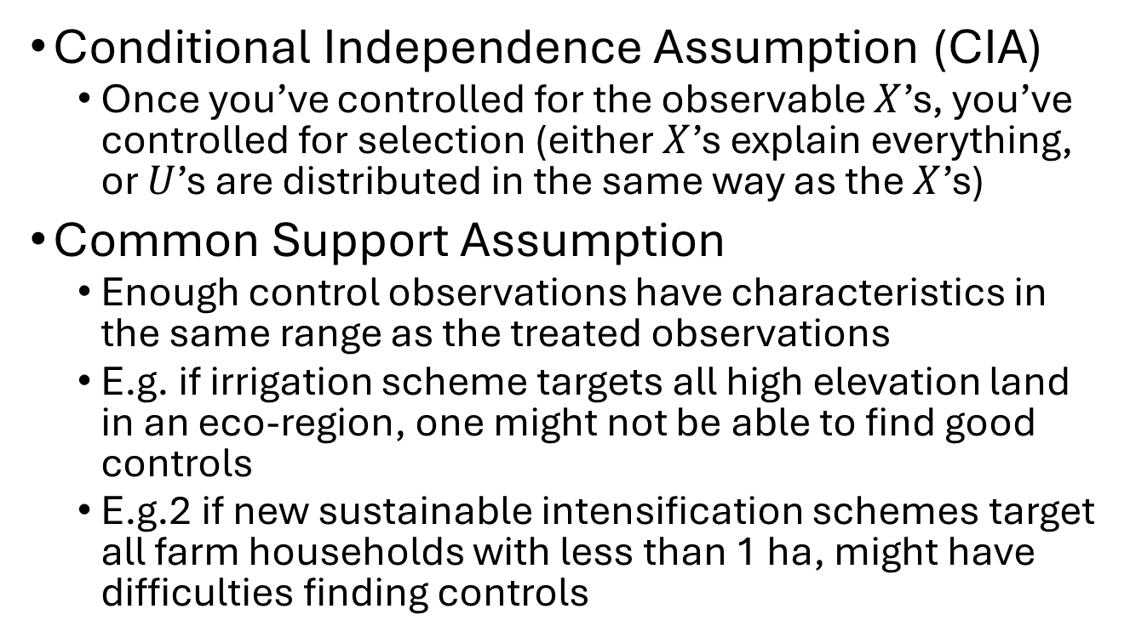
Assumptions Needed
Conditional Independence Assumption (CIA)
Once you’ve controlled for the observable $X$’s, you’ve controlled for selection (either $X$’s explain everything, or $U$’s are distributed in the same way as the $X$’s)
Common Support Assumption
Enough control observations have characteristics in the same range as the treated observations
E.g. if irrigation scheme targets all high elevation land in an eco-region, one might not be able to find good controls
E.g.2 if new sustainable intensification schemes target all farm households with less than 1 ha, might have difficulties finding controls

Slide 9
Types of Matching

Slide 10
Types of Matches
Characteristic matching (nn matching; mahalanobis matching)
Propensity Score Matching
Exact matching (stratified matching)
Caliper matching
Kernel matching

Slide 11
i | T | Edu | Income
1 | 0 | 2 | 60
2 | 0 | 3 | 80
3 | 0 | 5 | 90
4 | 0 | 12 | 200
5 | 1 | 5 | 100
6 | 1 | 3 | 80
7 | 1 | 4 | 90
8 | 1 | 2 | 70
From Heinrich et al 2010

Slide 12
i | T | Edu | Income | Match | Yi | Y0 | Diff
1 | 0 | 2 | 60
2 | 0 | 3 | 80
3 | 0 | 5 | 90
4 | 0 | 12 | 200
5 | 1 | 5 | 100 | [3] | 100 | 90 | 10
6 | 1 | 3 | 80 | [2] | 80 | 80 | 0
7 | 1 | 4 | 90 | [2,3] | 90 | 85 | 5
8 | 1 | 2 | 70 | [1] | 70 | 60 | 10
ATT = 6.25
Notes:
Nearest neighbor covariate matching

Slide 13
Dimensionality Issue
Can easily match over only one variable (dimension)
Once one has multiple variables, one needs to weight them and create an index
What is the appropriate weighting scheme?

Slide 14

Characteristic Matching
Y
Based on $X$’s, where they are weighted by inverse variance
X₁ slope, σ² = 5
X₂ wealth, σ² = 700
X₁
X₂

Slide 15

Characteristic Matching
Y
Based on $X$’s, where they are weighted by inverse variance
X₁ slope, σ² = 5
X₂ wealth, σ² = 700
Malahanobis: Proximity to the center of the mass of the treated
X₁
X₂

Slide 16
Characteristic Matching
Y
Based on $X$’s, where they are weighted by inverse variance
X₁ slope, σ² = 5
X₂ wealth, σ² = 700
Malahanobis: Proximity to the center of the mass of the treated
X₁
X₂

Slide 17
Characteristic Matching
Y
Based on $X$’s, where they are weighted by inverse variance
X₁ slope, σ² = 5
X₂ wealth, σ² = 700
Malahanobis: Proximity to the center of the mass of the treated
X₁
X₂

Slide 18
Characteristic Matching
Y
Based on $X$’s, where they are weighted by inverse variance
X₁ slope, σ² = 5
X₂ wealth, σ² = 700
Malahanobis: Proximity to the center of the mass of the treated
X₁
X₂

Slide 19

Characteristic Matching
Y
Based on $X$’s, where they are weighted by inverse variance
X₁ slope, σ² = 5
X₂ wealth, σ² = 700
Malahanobis: Proximity to the center of the mass of the treated
Different ways of measuring ‘distance’
X₁
X₂

Slide 20
Propensity Score Matching
Measure ‘distance’ by probability of treatment
First estimate the probability of treatment given observable characteristics using a probit or logit
Then predict that probability for all treated and control observations
Use these predicted probabilities as ‘coordinates’ to allocate which controls are near to which treatment observations

Slide 21
Common support
C
T
pscore
i.e. prob(T)

Slide 22
Exact Matching
Forcing the control observations to be exactly the same over some dimension
E.g. sex; ecoregion

Slide 23

How to define a ‘nearby’ control?
T
i
pscore
C
k
l
m
Pick ‘n’ closest observations in terms of propensity score, weighted equally: $\frac{1}{n}$
Pick a certain distance and include all observations within that distance
Weight observations using a kernel

Slide 24
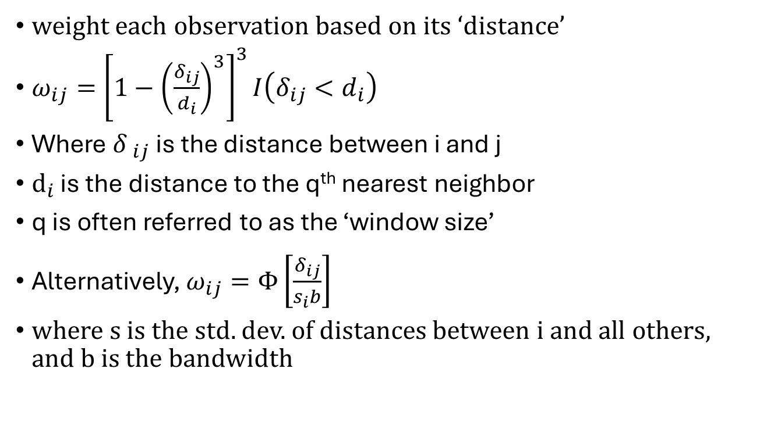
Kernel matching
weight each observation based on its ‘distance’
$ω_{ij}={\left[1−{\left(\frac{δ_{ij}}{d_{i}}\right)}^{3}\right]}^{3}I\left(δ_{ij}<d_{i}\right)$
Where ${δ }_{ij}$ is the distance between i and j
${\text{d}}_{i}$ is the distance to the q^{th} nearest neighbor
q is often referred to as the ‘window size’
Alternatively, $ω_{ij}=Φ{\left[\frac{δ_{ij}}{s_{i}b}\right]}^{}$
where s is the std. dev. of distances between i and all others, and b is the bandwidth

Slide 25
Effect of bandwidth on distance weights

Slide 26
Matching Options
With or without replacement
Weighted
Efficiency vs bias trade-off

Slide 27

How to Choose $X$’s and Run Specification Tests

Slide 28
How to Choose Covariates?
1. Things that affect selection into treatment
2. Things that affect outcome
If don’t condition on them in the estimation
Regressions on treatment and on outcome
Do not use characteristics that might be affected by treatment
Consider spillovers

Slide 29
Things to Keep in Mind…
Unlike a regression, adding in a covariate that doesn’t affect selection and/or outcome can matter
Ensure data for controls and treatment are from the same source (same frequency/granularity; same probability of missing etc)
Heterogeneity analysis – may want to match over subsets (exact matching)
E.g. gender in PSM
Notes:
Imagine more men are treated than women, and say women who are treated are older than the average treated male (female HH heads) (say ave 45 vs 65), but that age is a strong predictor of treatment
But we are interested in how treatment differs over gender
If we don’t match explicitly on gender, we may be comparing younger women (45) in the control to older women in the treatment, w/a if we fix sex and then look for characteristic matches, we may compare older women to older women and younger men to younger men

Slide 30
Pre-Survey Matching

Slide 31
What if we don’t want to throw away data?

Slide 32
Specification Tests
Covariate balance test
Including distribution
Multiple algorithms for robustness
Test to examine if results are sensitive to a few bad matches
Visual inspection of propensity scores (before and after)
Mapping

Slide 33
Checking X’s
Matched C
T
Farm size

Slide 34
But maybe…
C
T
Farm size

Slide 35
Matching and Difference-in-Difference

Slide 36
DiD Matching
Matching can be used in a DiD framework
Control for time-invariant unobservables
(Heckman Ichimura and Todd 1997; Heckman et al 1998)

Slide 37
Other options
Matching with Continuous Treatment (Imbens 2000)
Matching with a roll-out design

Slide 38
Measuring the degree of potential bias

Slide 39
Rosenbaum Bounds
Rosenbaum (2002): Identify “hidden bias” from unobservable covariates
Ask how much unobservables might affect results (make the ATT insignificant)
Specifically, estimates an odds ratio of how much could an unobserved variable bias outcome by affecting selection

Slide 40
e.g. Shah and Baylis
Comparing effect of parks across Indonesia
Do unobservable covariates affect whether individual park ATT is different from the national ATT (Γ₁)
Do unobservable covariates affect the park level ATT estimates (Γ₂)

Slide 41
Test for Hidden Bias
An unobservable that almost perfectly predicts deforestation would have to be allocated 1.7 more times to the control than the treatment for the treatment effect of national parks (on average) to not be statistically significant

Slide 42
Interpretation of the Γ
Lalonde (1985): effect of job training on wages
match on age, education, race, marital status, high school degree, earnings for the two years before the training program and unemployment before the training program.
ATT: 1767.7 (830.85); p.stat = 0.033; Γ = 1.05

Slide 43
Interpretation of the Γ
Lalonde (1985): effect of job training on wages
match on age, education, race, marital status, high school degree, earnings for the two years before the training program and unemployment before the training program.
ATT: 1767.7 (830.85); p.stat = 0.033; Γ = 1.05
If the odds of a person being in the program are 1.05 times higher than in the control due to an unobservable, the estimated treatment effect is no longer significant at the 0.05 level.

Slide 44
Interpretation of the Γ
Lalonde (1985): effect of job training on wages
match on age, education, race, marital status, high school degree, earnings for the two years before the training program and unemployment before the training program.
ATT: 1767.7 (830.85); p.stat = 0.033; Γ = 1.05
If the odds of a person being in the program are 1.05 times higher than in the control due to an unobservable, the estimated treatment effect is no longer significant at the 0.05 level.
If the odds of a person being in the training program are only 1.1 times higher b/c of an unobservable that affects income, the p-value as high as 0.127

Slide 45
Can also bound the estimated treatment effect
Median effect size if no difference in unobservables
If people are 1.5 times more likely to be in treatment due to an unobservable that affects income, the median treatment effect could be as high as $2424.80 or as low as -333.22

Slide 46
Can also bound the estimated treatment effect
Median effect size if no difference in unobservables
If people are 1.5 times more likely to be in treatment due to an unobservable that affects income, the median treatment effect could be as high as $2424.80 or as low as -333.22
Practical note: most socio-economic studies have Γ < 2.

Slide 47
Practical Issues
Unit of observation
Number of treated vs control
Can we afford to throw out controls?
Unobservables
Spillovers (contaminated controls)
Different data sources (what happens when you observe treated obs at greater granularity than controls?)

Slide 48



example
High-yielding seed variety introduced to a limited area
Treated Village
Potential Controls

Slide 49
example
1 to 1 matching
Treated Village
Matched Controls

Slide 50
example
Kernel matching
Treated Village
Weighted Matched Controls

Slide 51

example
Now assume only some people adopt

Slide 52
example
PSM

